Slide 1
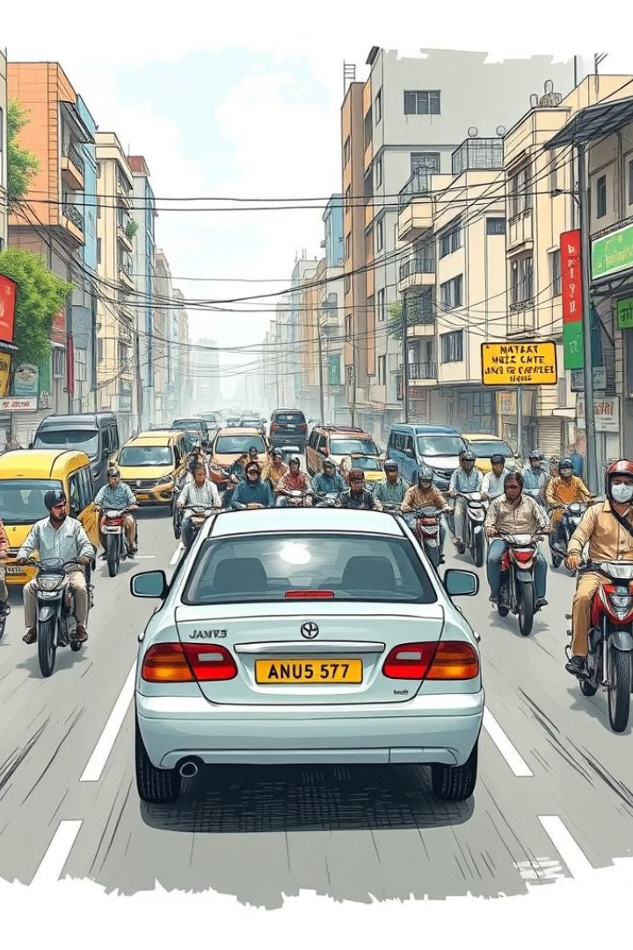
Car Pooling Service Application
An OOPS-based Java Project by Team Number 23:
Name
SAP ID
Batch
Armaan Arora 500124414 B1
Ahmad Shadan 500121810 B1
Paranjay Patil 500119642 B2

Slide 2
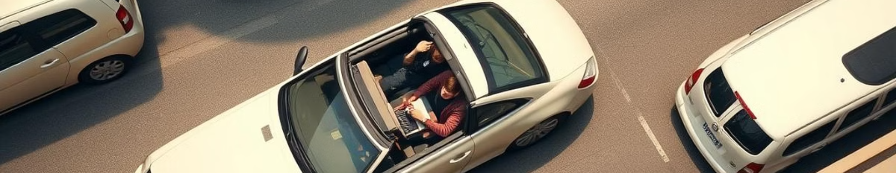
Problem Statement:
Current Issue: Lack of efficient ride-sharing solutions leads to high costs, environmental harm, and traffic congestion.
Example: A student traveling from UPES to Dehradun Railway Station pays a high fare for solo rides and struggles to find peers to share costs.
Need: A streamlined platform to connect users with similar routes for cost-effective, eco-friendly commuting.

Slide 3
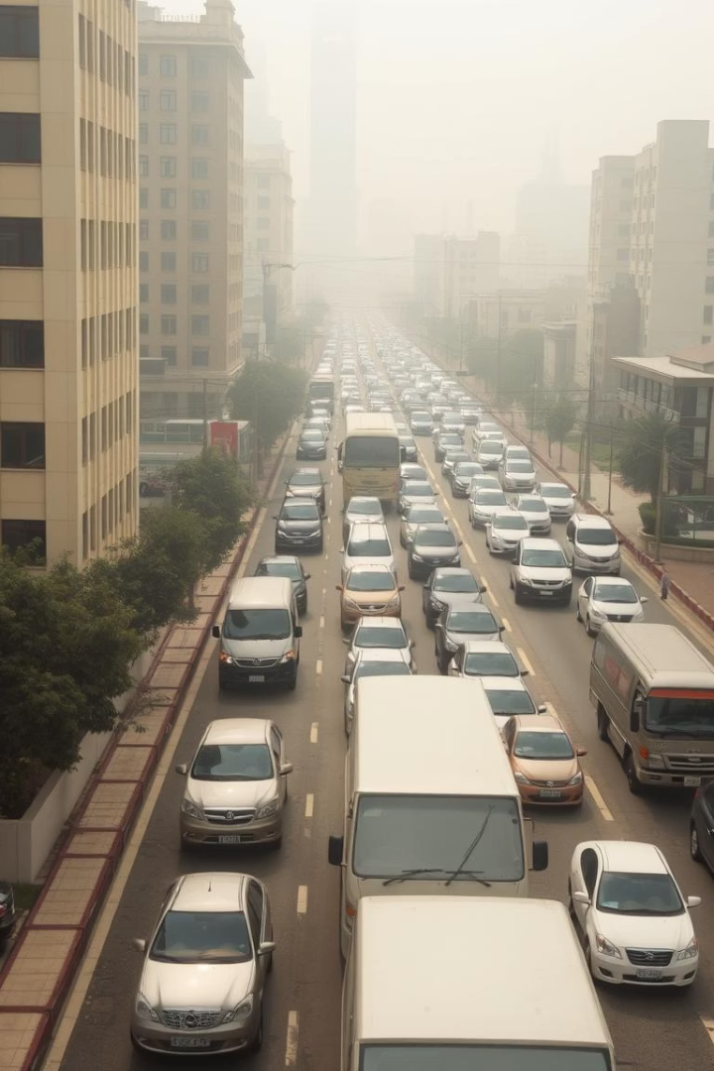




Project Objective
Our goals for the carpooling service app:
Primary Goal
Build a Java-based carpooling service app
Cost Reduction
Lower commuting costs by facilitating shared rides
Sustainability
Encourage sustainable travel practices
Technology
Ensure functionality and efficiency using Java, Swing, and SQLite

Slide 4

How Our Project Compares to Existing Solutions
Existing Solutions
Limitations
Our Solution
Uber Pool and Ola Share offer on-demand services. They have a large user base.
High commissions and surge pricing are problems. Services limited to urban areas.
We focus on localized, fair pricing and trust. Our prototype uses SAP ID verification.
On-demand availability
Broad coverage areas
High commissions
Localized focus: Tailored for students/communities (e.g., UPES to Dehradun routes).
Surge pricing
Limited to urban areas
Fair pricing
Verified user profiles.

Slide 5

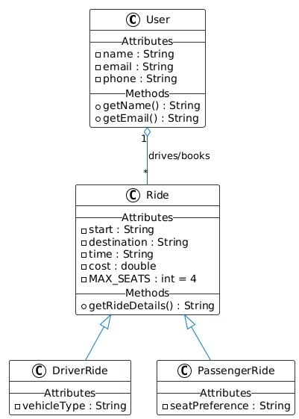
System Architecture
1. UML Class Diagram
1
Encapsulation
We use private attributes and public getters. This ensures data integrity.
2
Inheritance
DriverRide and PassengerRide extend the Ride class. This promotes code reuse.
3
Association
Users aggregate Rides via drives/books. This shows relationships.
4
Constraints
MAX_SEATS = 4 enforces vehicle capacity. It also keeps rides comfortable.

Slide 6

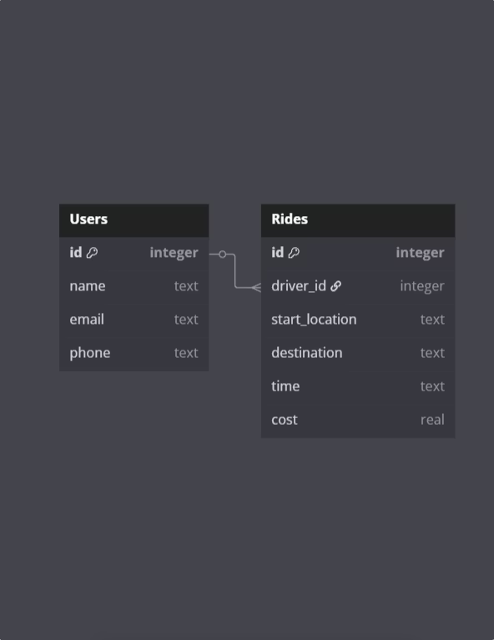



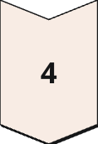

System Architecture
2. Database Schema
Users Table
Stores user profiles. It includes fields like ID and contact info.
Rides Table
Details rides with a driver_id, a foreign key. This ID links to Users.id.
Relationships
One-to-many: One User can create multiple Rides in the app.
Data Types
Use real for cost, and text for locations. These are optimized for our data.
Constraints
Email is UNIQUE in Users. driver_id ensures referential integrity.

Slide 7
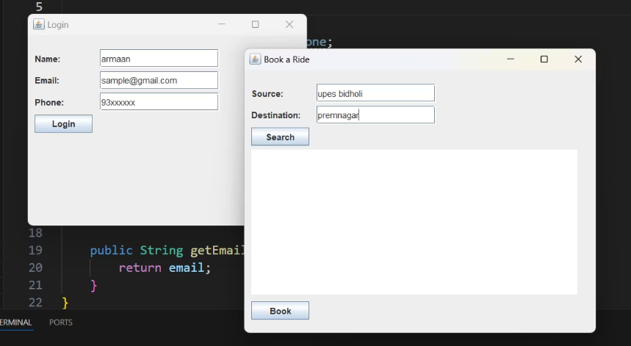
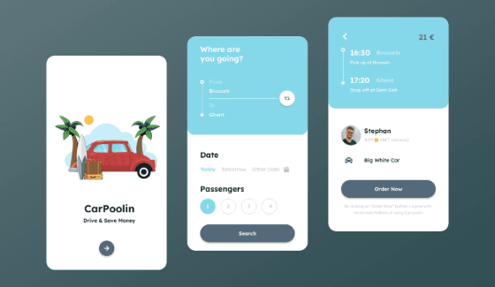
Innovation & Future Plans
Current Prototype
Future Work
Our current prototype features a
basic GUI built with Swing.
We are planning real-time notifications.
It uses an SQLite database for data management.
We will achieve this with Firebase integration
and a mobile app.
Functional carpool matching
Enhanced user experience
Simple user interface
Wider accessibility

Slide 8
OOPs in Action
Encapsulation
Inheritance
// User.java public class User { private String name; // Encapsulated attribute private String email; public String getName() { // Controlled access return this.name; } }
// Ride.java public class Ride { protected String start; // Inheritable attribute public void displayRideDetails() {...} } // DriverRide.java public class DriverRide extends Ride { // Inheritance private String vehicleType; }
Private attributes (name, email)
Public getters (getName())
maintain data integrity
extends keyword establishes
parent-child relationship
protected enables attribute sharing

Slide 9
OOPs in Action
Polymorphism
Abstraction
@Override enables runtime method selection.
Exposes only essential methods.
Same method, different behaviors.
Hides validation and routing logic.
Add PassengerRide variations easily.
Users see simplicity.
// Ride.java
public class Ride {
public void calculateFare() {
System.out.println("Basic fare calculation");
}
}
// DriverRide.java
public class DriverRide extends Ride {
@Override
public void calculateFare() {
System.out.println("Driver-specific fare");
}
}
// RideService.java
public class RideService {
public void requestRide(User user, String destination) {
// Complex validation and routing logic hidden
System.out.println("Ride requested for " + user.getName());
}
}

Slide 10
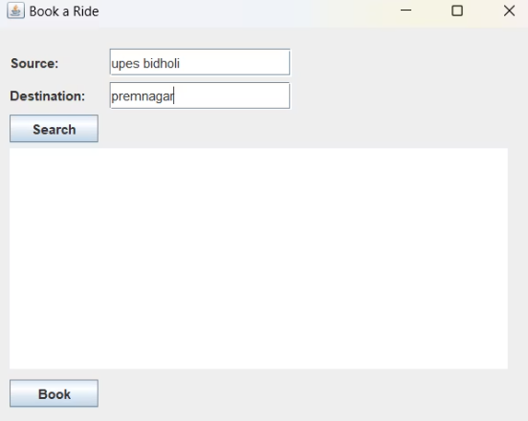
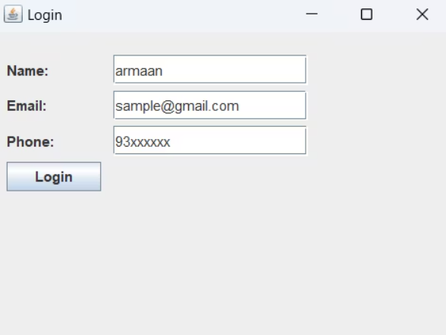
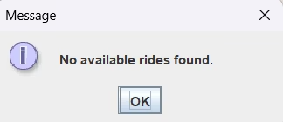
Results
2.Search Ride (e.g. UPES → Premnagar)
Demo Workflow
Register → Login (Swing GUI)
3. If found: Book & Split Cost
And If not found:

Slide 11
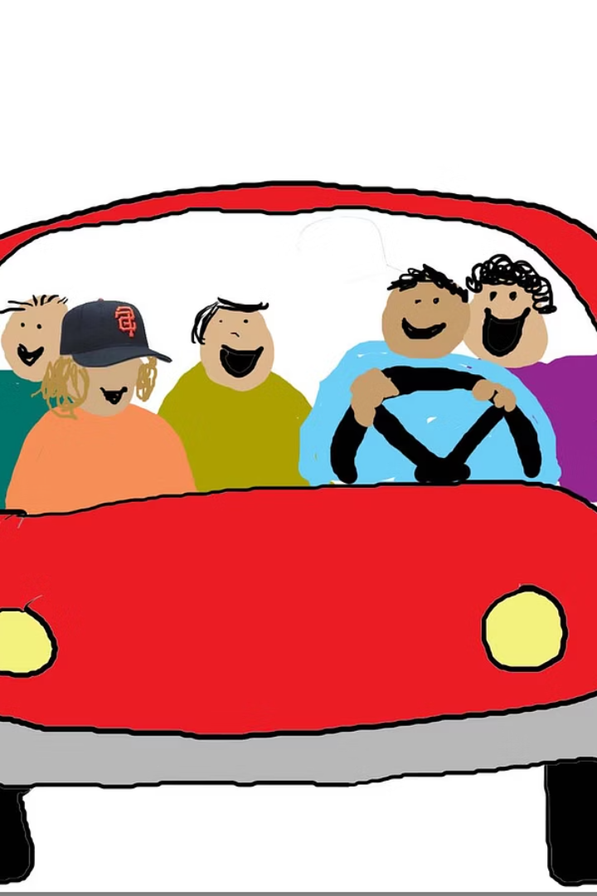
Thank you
We hope you found our presentation informative.
Project Success
Key Takeaways
Our carpooling app offers a practical solution. It improves efficiency and lowers costs.
The app promotes sustainability. It reduces emissions and enhances community.
Future Steps
We aim to scale the application. It can reach a larger audience, enhancing its impact.

